Slide 1
Secure Angular Programming
presented by Spencer Sundrud

Slide 2
Overview
In-built methods and features
XSS
Sanitization
Error Messages
Session Hijacking

Slide 3
Assumptions
Working knowledge of Angular
Basic secure programming practices
Scope of project is only on the front-end - no backend coding

Slide 4
In-built methods and features
Consistent updates - make sure to use the latest libraries available
Automatic sanitation - does not trust user input, escapes untrusted values
Very few vectors of attack

Slide 5
XSS
Treat all templates as executable code! All inputs, including custom user names, should be sanitized before being used to render any element.
Don’t break the system - use sanitizer libraries instead of disabling security features.
Best practice:
Use [innerHTML] or {{ }} tags to remove scripting, etc.

Slide 6
Sanitation
As mentioned before, use things like DOMSanitizer APIs to sanitize data. Assume the backend code has horrible security, and never passed an untrusted string back to them.
Best practice:
Use the bypassSecurity function sparingly, if at all. It is literally a bypass to all inbuilt sanitation measures.

Slide 7
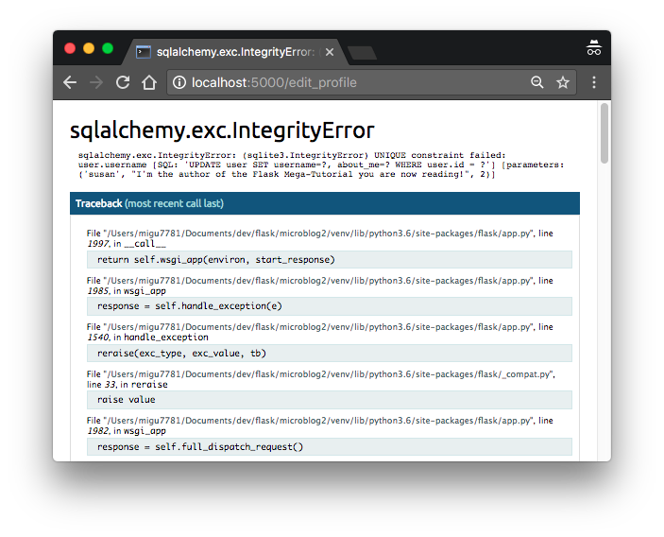
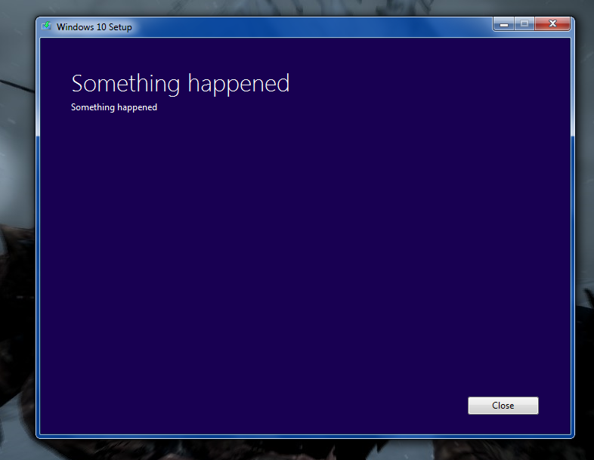
Error Messages
Best practice:
Something in between these two. Give enough information for a user to be able to troubleshoot, but not enough for an attacker to get confidential information.

Slide 8
Session Hijacking
My responsibility to work with OpenID Connect. In short, we will use open-source algorithms already implemented in production-level projects to ensure that authentications are secure, and the session cannot be replicated by a separate party.
Best practice:
Don’t write your own code - we will rely on others’ expertise on actual authentication protocol, modified for our system.

Slide 9

Questions?

Slide 10
Sources and resources
https://angular.io/guide/security
https://www.youtube.com/watch?v=WK2qc4U405I
https://ripcordsystems.com/2019/03/09/angular-how-to-prevent-xss-attacks-code-examples/
https://www.hindawi.com/journals/scn/2018/6315039/

